Slide 1
Capstone II: Driving Factors of Home Prices
Stephanie Kirk
Data Analytics Capstone II| Thinkful

Slide 2
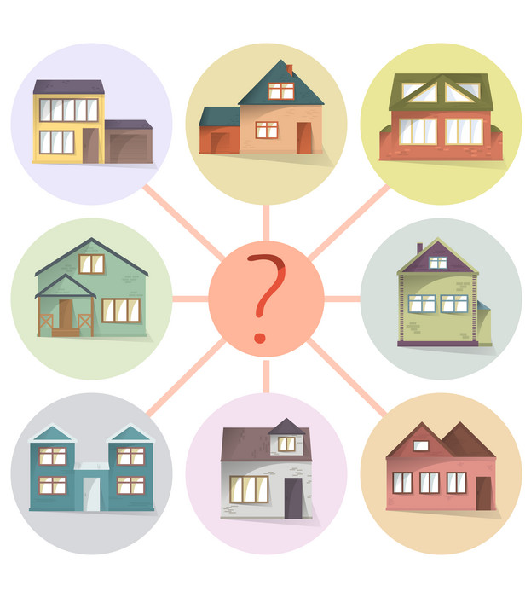
Objective
Determine what factors drive housing prices
Provide recommendations on how investment dollars should be allocated into mortgage-backed securities

Slide 3
My Hypothesis
Important factors of sale price are specific details of the home
I hypothesis that the below are factors that drive home prices:
Number of Stories
Above Ground Living Space
Garage Capacity
Number of Fireplaces
Before and After Lead Paint (1978)
Pool vs No Pool

Slide 4
The Data
The data consisted of a sample size of 1460 homes in Ames, Iowa that were sold between 2006 and 2010.
The data set is made up of 80 columns and is approximately evenly distributed.
The data used in my analysis was pulled from Kaggle: https://www.kaggle.com/alphaepsilon/housing-prices-dataset
*Descriptive Statistics for Housing Prices Dataset

Slide 5
Methods
Chose variables that stood out as having greatest impact on home prices
Split variable into groups using Excel’s pivot table filtering
Conducted two-sample t-tests using Analysis Toolpak in Excel assuming unequal variances
Determined impact level by calculating percent of mean difference to average sale price of the sample
No Impact
Low Impact
High Impact
Pool vs No Pool
Above ground living space between 3000-4000 and >4000 sq ft
Houses with 2 vs 3 fireplaces
Number of Stories
Number of Fireplaces 0 vs 1 and 1 vs 2
Garage capacity 0 vs 1 and 1 vs 2 Cars
Above ground living space <1000 and 1000-2000 sq ft
Garage capacity 2 vs 3 and 3 vs 4 cars
Above ground living space 1000-2000 vs 2000-3000 sq ft and 2000-3000 vs 3000-4000 sq ft
Before and After Lead Paint Ban (1978)

Slide 6
Garage Capacity
Succeed in rejecting the null with 95% confidence and p-value of <.006
Garage capacity of 2 vs 3 cars high positive impact
With 95% confidence, homes with 3 car garages sell for between $109,729 and $141,839 more than 2 car garages.
Garage capacity 3 vs 4 cars high negative impact
With 95% confidence, homes with 4 car garages sell for between $53,135 and $180,825 less than 3 car garages.

Slide 7
Above Ground Living
Succeed in rejecting the null with 95% confidence
Above ground living space of 1000-2000 vs 2000-3000 sq ft
p value ≈ 0
Average sale price is between $83,597 and $110,486 higher
Above ground living space of 2000-3000 vs 3000-4000 sq ft
p value = .02
Average sale price is between $17,210 and $174,492 higher

Slide 8
Lead Paint Ban
Succeed in rejecting the null with 95% confidence there is no difference in homes sold before and after 1978 with p value ≈ 0
Avg. sale price of homes built after 1978 are significantly higher than those built prior to that date.
Homes built after 1978 will sell for between $82,118 to $96,923 more.

Slide 9
Recommendations
Focus on high impact home factors:
Garages with a car capacity of 3
Above ground living spaces of 2000 to 4000 sq ft with between 3000-4000 sq ft being best
After lead paint ban (1978)
Avoid homes with:
4 car garages high negative impact on sale price

Slide 10

Questions
Contact:
sakirk@csbsju.edu

